Slide 1
Comparative Analysis of Player and Team Performance in Major European Soccer Leagues
A Study of Core Metrics from 2011/2012 to 2015/2016

Slide 2
RESEARCH QUESTION
How do player and team performance core metrics vary across the major European soccer leagues between 5 seasons, and what factors contribute to these performance differences?

Slide 3
Player Performance Consistency
League Comparison on Key Metrics
Seasonal Performance Trends
Hypothesis 3: La Liga will have the highest average goals scored per season, due to its offensive attacking style of play.
Hypothesis 4: Serie A teams will have lower average goals conceded per match, highlighting the league's strong defensive focus.
Hypothesis 5: There will be a significant upward trend in number of goals across all leagues from 2011/2012 to 2015/2016, indicating improving competitiveness quality over time.
Hypothesis 6: Number of matches will increase over the five-year period due to increasing teams joining the big leagues.
Hypothesis 1: Players in La Liga will have higher build up play speed compared to other leagues, reflecting the traditionally more offensive playing style.
Hypothesis 2: The La Liga will have most players with highest ratings due to its competitive nature and focus on youth development.

Slide 4
Challenges
The data is very comprehensive so I put a better focus on 5 major leagues and 5 seasons
There are many outliers, especially in the
The data is stored in a relational database so I have to find the key to connect as their column names are different
I have to use the matches table as primary table to join with the team one then join the new_player table.
The season is formatted as 2011/2012 so I have to split the season string into its components for calculation.
The second dataset doesn’t match the season of the main one

Slide 5
TABLE OF CONTENTS
1
2
3
4
HISTORY
PRESENTATION
Here you could describe the topic of the section
Here you could describe the topic of the section
ANALYSIS
CONCLUSION
Here you could describe the topic of the section
Here you could describe the topic of the section

Slide 6
WHOA!
This could be the part of the presentation where you can introduce yourself, write your email…

Slide 7
INTRODUCTION
Mercury is the closest planet to the Sun and the smallest one in the Solar System—it’s only a bit larger than the Moon. The planet’s name has nothing to do with the liquid metal

Slide 8
1
HISTORY
You can enter a subtitle here if you need it

Slide 9

A PICTURE ALWAYS REINFORCES THE CONCEPT
Images reveal large amounts of data, so remember: use an image instead of long texts

Slide 10
THE SLIDES TITLE GOES HERE!
Do you know what helps you make your point clear? Lists like this one:
They’re simple
You can organize your ideas clearly
You’ll never forget to buy milk!
And the most important thing: the audience won’t miss the point of your presentation

Slide 11

A PICTURE IS WORTH A THOUSAND WORDS

Slide 12
MAYBE YOU NEED TO DIVIDE THE CONTENT
MERCURY
VENUS
Mercury is the closest planet to the Sun and the smallest one
Venus has a beautiful name and is the second planet from the Sun

Slide 13
...OR MAYBE YOU COULD USE THREE COLUMNS
MARS
VENUS
MERCURY
Despite being red, Mars is a very cold place full of iron oxide dust
Venus has a beautiful name and is the second planet from the Sun
Mercury is the closest planet to the Sun and the smallest one

Slide 14
YOU COULD USE FOUR COLUMNS, WHY NOT?
SATURN
MERCURY
VENUS
MARS
Saturn is composed mostly of hydrogen and also of helium
Mercury is the closest planet to the Sun and the smallest one
Venus has a beautiful name and is the second planet from the Sun
Despite being red, Mars is a very cold place full of iron oxide dust

Slide 15
AWESOME WORDS

Slide 16
6,777,000
Big numbers catch your audience’s attention

Slide 17
INFOGRAPHICS MAKE YOUR IDEA UNDERSTANDABLE...
EARTH
MARS
SATURN
MERCURY
Earth is the third planet from the Sun
Despite being red, Mars is a very cold place
Saturn is composed mostly of hydrogen
Mercury is the closest planet to the Sun

Slide 18
HOW ABOUT PERCENTAGES?
50%
30%
20%
VENUS
MARS
MERCURY
Venus has a beautiful name, but it’s hot
Despite being red, Mars is a very cold place
Mercury is the closest planet to the Sun

Slide 19
THIS IS A TABLE
 | TEAM 1 | TEAM 2 | TEAM 3 | TEAM 4
GROUPS | 20 times | 45 times | 33 times | 12 times
QUARTERFINAL | 8 times | 20 times | 4 times | 4 times
SEMIFINAL | 2 times | 20 times | 20 times | 5 times
FINAL | 5 times | 2 times | 7 times | 3 times

Slide 20
FOUR COLUMNS
SATURN
MERCURY
VENUS
EARTH
Saturn is composed mostly of hydrogen
Mercury is the closest planet to the Sun
Venus has a beautiful name, but it’s hot
Earth is the third planet from the Sun

Slide 21
MAYBE YOU COULD USE THESE FIVE COLUMNS
SATURN
VENUS
MERCURY
MARS
EARTH
Saturn is composed mostly of hydrogen and helium
Venus has a beautiful name, but it’s hot
Mercury is the closest planet to the Sun
Despite being red, Mars is a very cold place, not hot
Earth is the third planet from the Sun

Slide 22
THIS IS A TIMELINE
GROUPS
SEMIFINAL
QUARTERFINAL
FINAL
Despite being red, Mars is a very cold place
Earth is the third planet from the Sun
Saturn is composed mostly of hydrogen
Mercury is the closest planet to the Sun

Slide 23
THIS IS A MAP
VENUS
MARS
SATURN
MERCURY
Venus has a beautiful name
Despite being red, Mars is a cold place
It is composed mostly of hydrogen
Mercury is the smallest planet

Slide 24
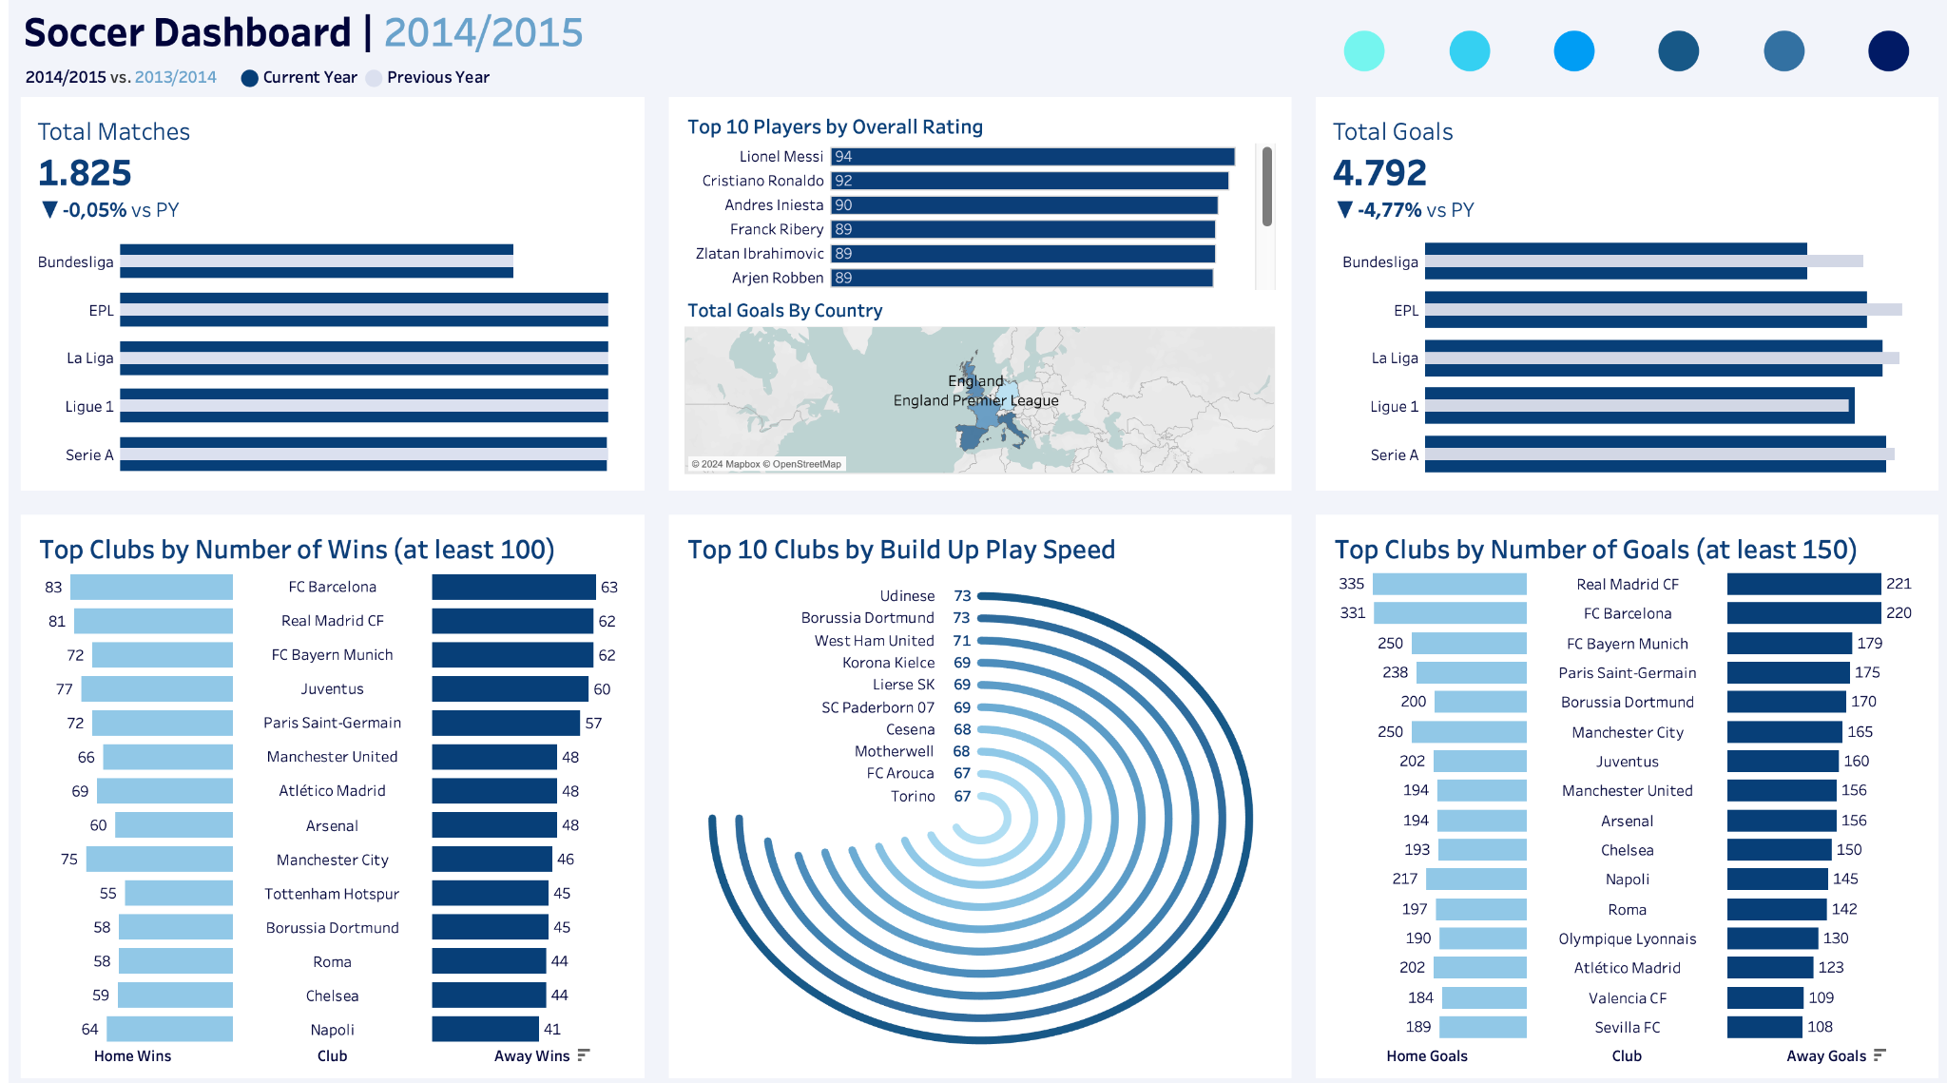
DESKTOP DASHBOARD

Slide 25
THANKS!
Do you have any questions?
tnguy354@uic.edu
+1 872 258 6434

